Slide 1
DATA ANALYTICS // EXPLORATORY ANALYSIS
PYTHON EDA REPORT
Retail Sales Data Analysis
Evaluating Customer Segments, Product Categories, Regional Trends, and Shipping Durations to Drive Data-Driven Decision Making.
DATASET
STACK
METHODOLOGY
Superstore Sales Dataset
Pandas, NumPy, Matplotlib, Seaborn
Exploratory Data Analysis (EDA)

Slide 2

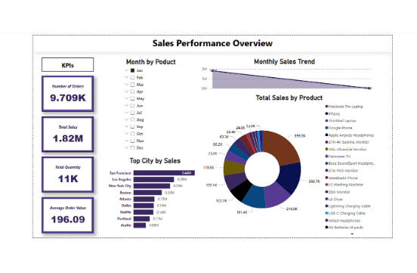
FRAMEWORK
Project Context & Analytic Stack
Business Objective
Understand sales drivers across regional markets and product categories while discovering operational bottlenecks in order fulfillment.
Data Scope
Analyzed transaction-level records covering Order Dates, Customer Segments, Regional Geography, Categories, and Shipping Modes.

Slide 3
WORKFLOW
End-to-End Analysis Pipeline
01
02
03
04
Data Cleaning
Feature Engineering
Exploratory Analysis
Visual Insights
Missing-value checks, duplicate removal, type casting.
Derived shipping duration from Order and Ship dates.
Aggregated sales across segments, regions, categories.
Generated heatmaps, revenue charts, and delivery trends.

Slide 4
ANALYSIS
Key Performance Findings
Product & Category Concentration
Geographic & Segment Variance
Fulfillment & Shipping Speed
Technology and Furniture lead total sales volume.
Consumer segment generates highest total order volume.
Standard Class shipping averages longest processing delays.

Slide 5
STRATEGY
Prescriptive Recommendations
Inventory Optimization
Targeted Segment Marketing
Prioritize high-revenue categories to eliminate stockouts.
Focus campaigns on high-performing consumer segments.
Fulfillment Optimization
Regional Market Growth
Streamline warehouse dispatching for Standard Class shipping.
Investigate lower-performing regions to unlock demand.

Slide 6

Thank You
Open for Discussion & Questions
Retail Sales Analysis
•
Python Data Analytics Project

Slide 7

Image Sources
https://miro.medium.com/v2/resize:fit:1400/1*_jbb6-TIVK2J6O_WCFYXIw.png
Source: medium.com

